Slide 1




NEXT GEN EMPLOYABILITY PROGRAM
Creating a future-ready workforce
Team Members
College Name
Student Name :Rudresh R
Student ID :720921243048
JCT College of Engineering & Technology-Coimbatore

Slide 2

CAPSTONE PROJECT SHOWCASE
Project Title
Notes Sharing Web Application using Django Framework
Abstract | Problem Statement | Project Overview | Proposed Solution | Technology Used | Modelling & Results | Conclusion

Slide 3
Abstract
In today's digital age, the demand for convenient and effective educational tools is more pressing than ever. This paper introduces a collaborative notes sharing web application designed to address this need by facilitating the exchange of academic materials among students. Leveraging the Django framework, a powerful Python web framework known for its rapid development and pragmatic design, this platform provides a robust space for users to upload, download, and share notes in various file formats. The system architecture follows Django's Model-View-Template (MVT) pattern, ensuring scalability, clear organization, and easy maintenance. Noteworthy features include user authentication, file management functionalities, a search feature for quick access to specific materials, and a categorization system to organize notes by subject, topic, or course. Initial testing has shown positive feedback from users, indicating an intuitive interface and potential to improve the learning experience through collaborative study and resource sharing. Future enhancements will focus on adding advanced capabilities like collaborative editing, integration with cloud storage, and the use of machine learning to recommend personalized content based on user preferences and study patterns.
Source :Gpt 4

Slide 4
Problem Statement
This project addresses a pressing issue: the absence of a user-friendly, efficient, and collaborative platform tailored for students and educators to share and manage academic notes and materials. While numerous online platforms exist, there's still a noticeable gap in services dedicated to academic collaboration. As a result, many students rely on disjointed and less secure methods to share study resources. The objective here is to utilize the Django framework to create a secure, scalable, and intuitive web application. It aims to streamline the sharing and organization of notes while fostering collaboration and community engagement to enrich the learning process.
Source :

Slide 5
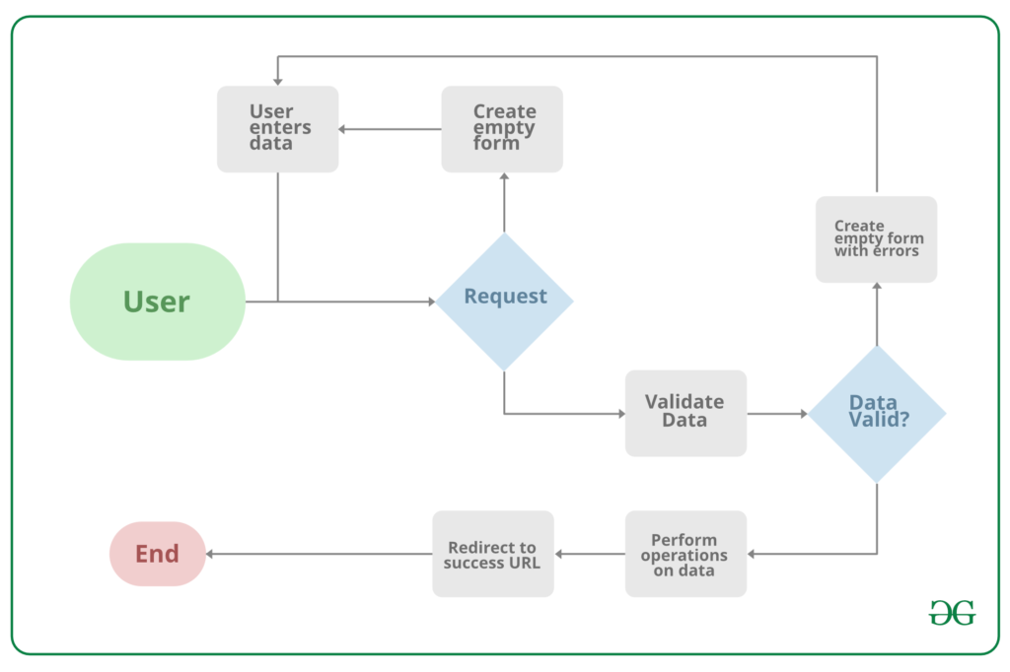
Project Overview
Source :google

Slide 6
Proposed Solution
The proposed solution entails creating a robust and secure Notes Sharing Web Application designed specifically for students, educators, and academic institutions. This application will harness the capabilities of the Django framework, known for its reliability, security features, and scalability. Here's an overview of the main elements of the proposed solution:
1. System Architecture
- Backend Development: Utilization of Django for server-side operations like logic handling, database management, user authentication, and session management, ensuring a sturdy backend structure.
- Frontend Integration: Integration of HTML, CSS, and JavaScript with Django's template system to craft a user-friendly and responsive interface, enhancing user interaction.
- Database Design: Creation of an efficient relational database schema to store user details, notes, categories, and interactions securely and allow for quick retrieval of information.
2. Core Features
- User Authentication and Authorization: Implementation of Django's authentication system to manage user accounts securely, handle login/logout processes, and protect user data privacy.
- Notes Management: Empowerment of users to upload, download, and organize notes in various formats (PDF, DOCX, PPT, etc.), including functionalities for note creation, editing, and deletion.
- Collaboration Tools: Integration of tools that allow users to comment on notes, rate them, and engage in discussions, fostering a collaborative and interactive learning atmosphere.
.
Source : GPT 4

Slide 7
3. Security and Privacy
To fortify the application, Django's best security practices will be implemented to thwart common threats like SQL injection, Cross-Site Scripting (XSS), and Cross-Site Request Forgery (CSRF). Additionally, stringent data privacy measures, aligned with regulations such as GDPR, will be enforced to safeguard personal information.
4. Scalability and Performance
The application's architecture will prioritize scalability to seamlessly accommodate growing user numbers and data volume without compromising performance. Leveraging Django's caching framework will further enhance performance by reducing server load and improving response times.
5. User Experience (UX) Design
A user-centric design approach will guide the development of an intuitive and engaging platform. The user interface (UI) will be tailored to meet the specific needs and preferences of the target audience, ensuring an accessible and enjoyable experience. Responsive design principles will be applied to guarantee the application's usability across various devices and screen sizes.
6. Testing and Quality Assurance
To ensure reliability and user-friendliness, thorough testing methodologies will be employed. This includes rigorous unit tests, integration tests, and user acceptance testing (UAT). Django's testing framework will be utilized to automate test cases, ensuring code integrity and a robust application.
Source :GPT 4

Slide 8


Technology Used
Front-end
Back-end
Source :

Slide 9
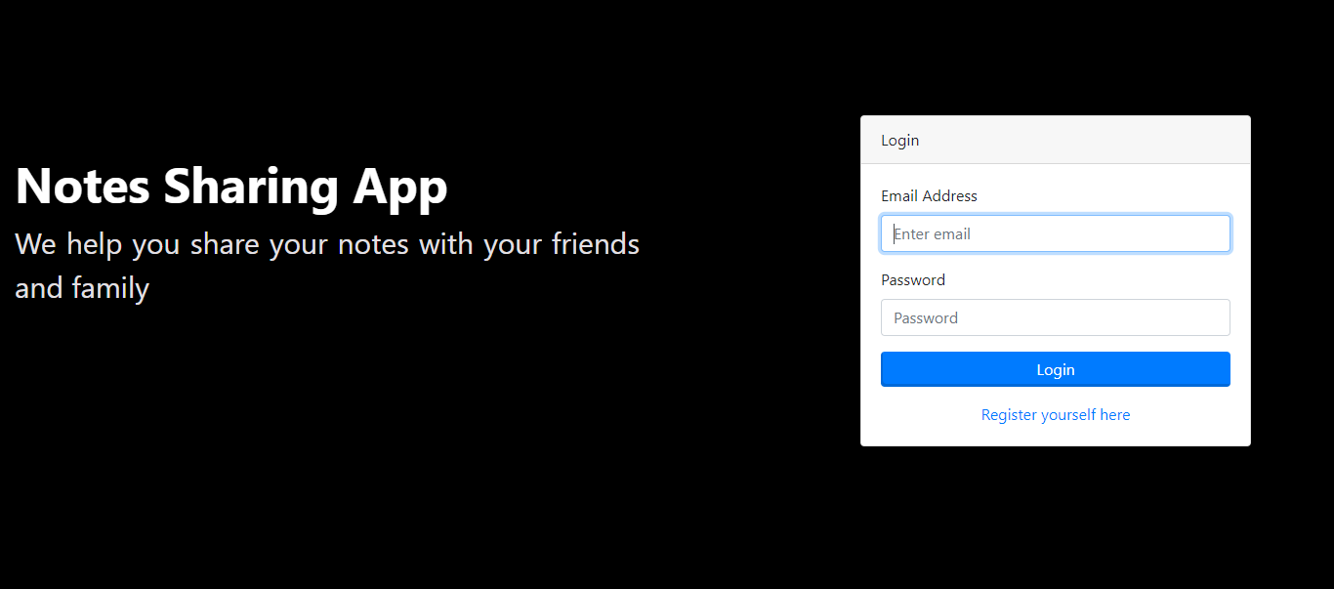
Modelling & Results
Source :

Slide 10
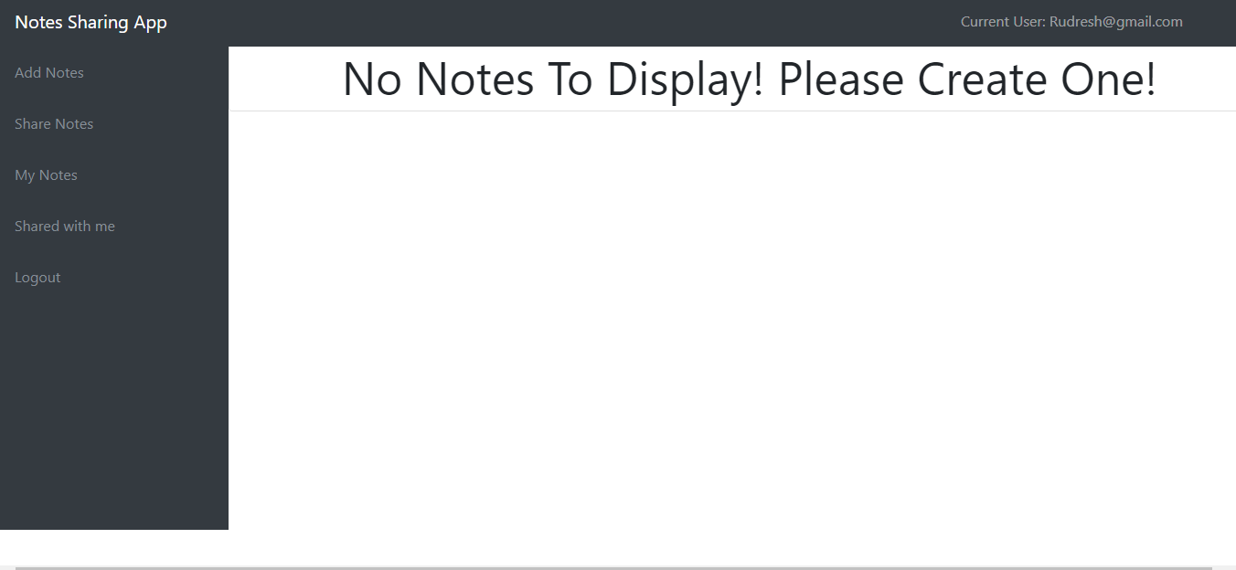
User-Profile

Slide 11
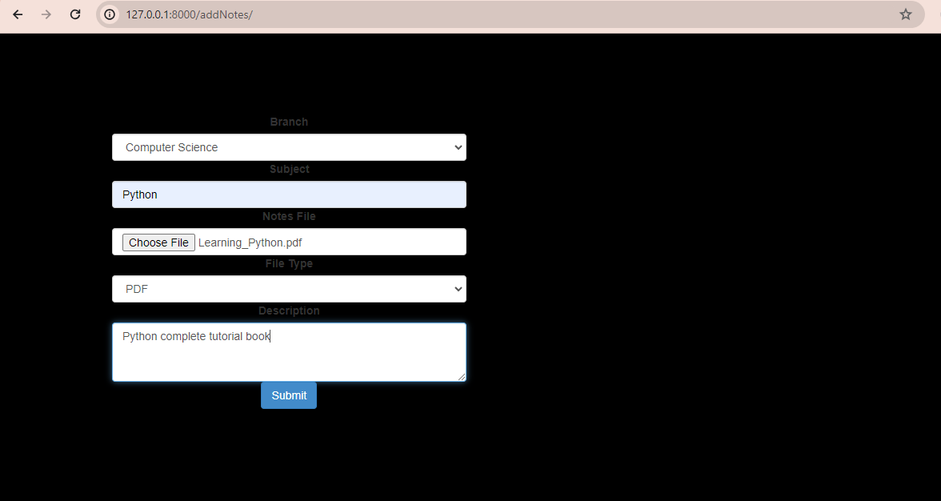
Add notes page

Slide 12
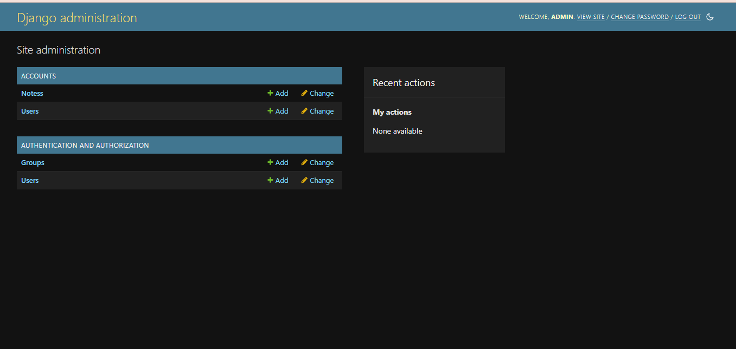
Admin-Page

Slide 13
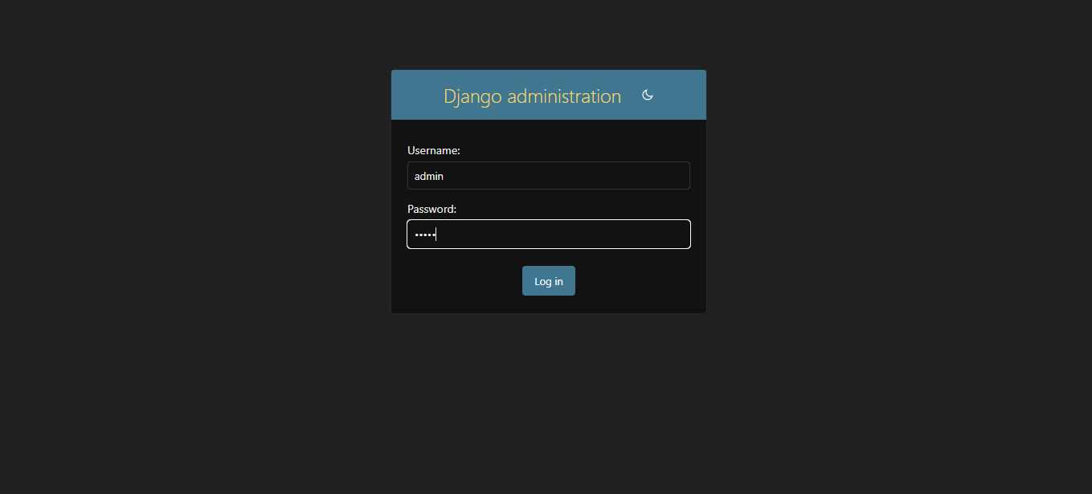
Departments-Page

Slide 14
Future Enhancements:
1. Artificial Intelligence and Machine Learning Integration
To enrich the user experience, advanced AI and machine learning techniques will be integrated into the platform. A sophisticated content recommendation system will be developed, leveraging machine learning algorithms to analyze user behavior and preferences. This system will provide personalized note recommendations tailored to individual users. Additionally, natural language processing (NLP) techniques will be employed to automatically categorize uploaded notes based on their content, streamlining the organization process and enhancing resource discoverability.
2. Enhanced Collaboration Features
To foster greater collaboration among users, real-time collaboration tools will be introduced. This includes features such as simultaneous editing and commenting, akin to the functionality offered by Google Docs. Furthermore, the platform will facilitate the creation and management of study groups, allowing users to collaborate in a structured and organized manner, thereby enhancing the overall learning experience.
3. Integration with External Platforms
The platform will offer seamless integration with popular cloud storage services such as Google Drive and Dropbox, enabling users to easily upload and backup their notes. Additionally, integration with other educational platforms and tools will be provided, allowing users to access a diverse array of resources and tools directly from within the application. This integration will streamline workflows and enhance the overall utility of the platform for users.

Slide 15
Conclusion
In conclusion, note sharing applications represent invaluable tools for fostering collaboration, knowledge exchange, and organization across various domains. Whether utilized for educational, professional, or personal purposes, these platforms offer a centralized space for users to create, share, and collaborate on notes. By facilitating efficient communication, enhancing productivity, and fostering learning and growth, note sharing applications empower individuals, teams, and communities to connect and succeed in the digital age. As technology evolves, the importance and impact of these applications are expected to increase, providing vital support for collaboration and knowledge sharing in diverse contexts.
Source :

Slide 16
Thank You!
Notes:
Thank You !!

